Slide 1

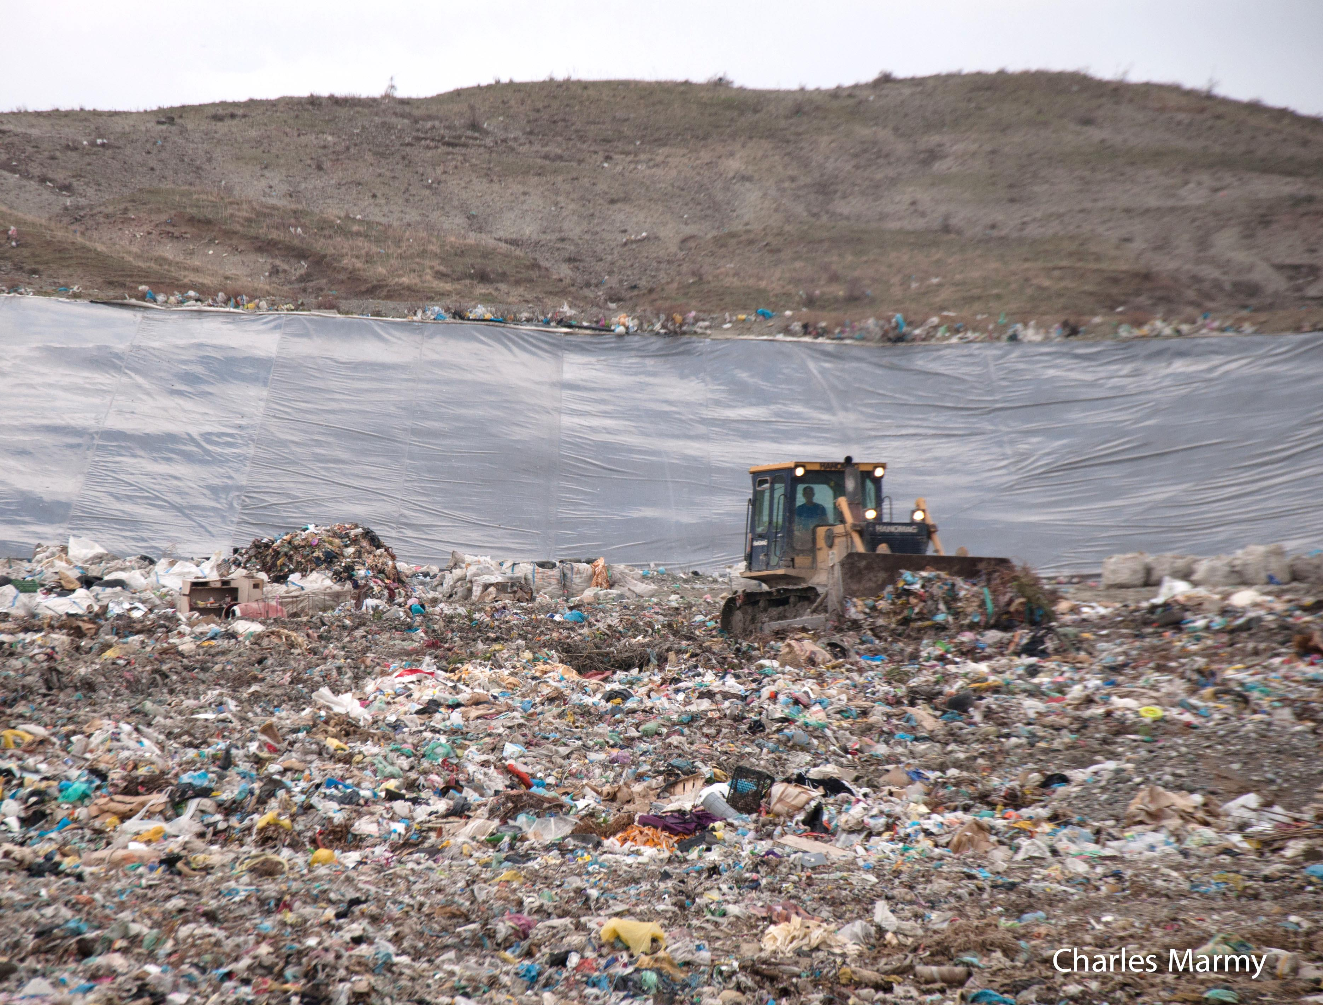
Local waste planning
Félix Schmidt
CSD engineers SA
Territorial Reform and Waste Management
Situation 1 year after the TAR
June 2016
Notes:
Start a planning process
New consideration => presentation
Methodology developed together with Eduart (REC)

Slide 2
Summary
  One year ago, where were we ?
  One year after TAR, where are we ?
    Sector
    LGU
    Capacity building
  What are the challenges ?
  What are the trends ?
Notes:
Total 3 hours, depends on questions and discussion

Slide 3
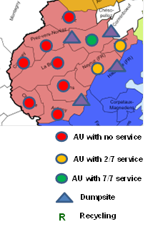
  One year ago, where were we ?
  Proposition of a working plan for application of TAR in Waste Management Service:
  Initial Audit of existing situation of service
    Data collection
    Identification of main risks for the continuation of service, and of main points needing a specific short term action
  Short term action plan
  Long term waste management plan
    Cost, budget and tariff calculation
    Organize and extend a fee collection system
    Tenders, contracts
    Rules and regulations
    Training, communication

Slide 4
  One year ago, where were we ?
  Selection of 5 LGU interested in first Audit
    Shkodra, Puka, Lezha, Malsia–Madhë and Kukës
      Contracts to service providers for
        Service audit
        Short time action plans
  Development of integrated Waste management plans
    Shkodra, Puka, Lezha, Malsia–Madhë, Dibra, Shijak
      Cost calculation
      Tender documents for PP delegation, if any
      Budget and technical specification for short terms investments (bins, trucks)
      Risk analysis and proposition of short terms measures for dumpsite management
  Finalization in 2016

Slide 7
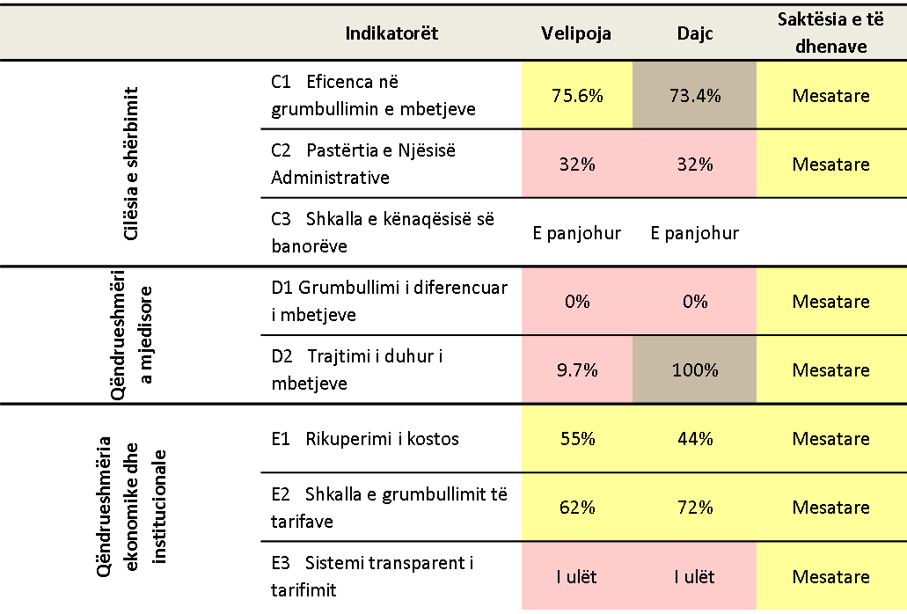
  1 year after TAR, where are we ?
Sector
- Important influence of new Law on Local Governance and discussions of future Law on Local Finances concerning waste management service.
  Introduction of Performance Indicators and Performance Measurements
    as a basis of communication with Council and Population
  Mention of Standards and National Minimum Standards
  Mention of Geospatial different Standards at the Municipal level (art. 94)
  Introduction of Supervision and Monitoring principles (art. 13) of the local services, in the direction of a Bench-Marking comparison of performance and good practices of the service

Slide 8
1 year after TAR, where are we ?
  LGU : main results of the Audit
    Each have different approach and short term action plans
      Service standards
      Shkodra: 3 different services zones: urban, rural, beaches, with a clear priority to the beaches/touristic area (high demand, high potential of tariff recovery, high production of recyclable waste)
      Lezha: 2 service zones; priority of extending the service to rural area
      Environment
      Identification of dumpsites, with specific main risks
      Malesia-Madhe: reduction of dumpsites from 3 to 1
      Operation
      Some want to open to PPP concurrence, some to develop public service
      Some want to use free capacity to develop service (Shkodra)
      Constrains of existing contract are frecuent
      Finance
      Identification of big gaps between tariff collection and necessary resources -> new objectives for tariff collection

Slide 9
1 year after TAR, where are we ?
  Capacity building: better professionalization of waste management actors
    Contact and/or collaboration with a majority of new local authorities
    Waste management leader identified
    Training curricula and trainers were developed
    Training ongoing of waste management leaders (34 / 61)
      Waste management planning : done
      Cost calculation : July
      Tariff elaboration and tariff collection : July
      Information and Monitoring : Sept-Oct.
      Bench marking and performance indicators : November
    Contribution to the further development of (7) sectorial service providers

Slide 10
Challenges 1 : lack of data
    1. Lack of data
      Big difficulties to get data and bad quality of data
        Waste producers : population, businesses
        Waste production : measured quantities
        Roads: transport time and service area
        Service cost, tariff collection, etc.

Slide 11
Challenges 2 : lack of resources
    2 : Lack of resources
      Financial and technical resources
      Not enough resources to provide everywhere a good service
      Not enough trucks and bins, limited investment capacities
      Maintenance deficiency
      Human resources
      Needs of capacity building and clarification of tasks at every level, especially in planning and organizing the collection, transport, recycling activities, cost calculation and cost recovery.
      Needs of clarification of local/centralized provision of tasks and supervision

Slide 12
Challenge 3 : regional treatment
  3: Difficulty of defining new landfill in LGU WMP:
    Landfill should have regional role and large capacity
    Work (engineering, investment, management, cost…) exceeding capacity of each new Municipality alone
    Dumpsites management and closure needs specific analyze and additional resources.

Slide 13

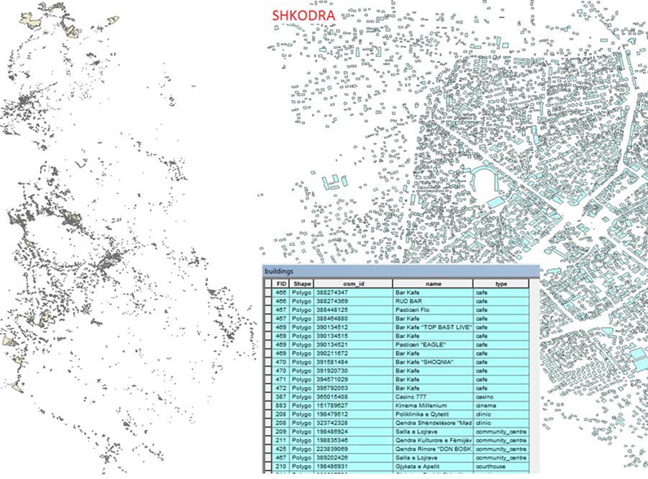
Trends : facing the lack of data
Using free GIS tools with new available data
Example
Position of all buildings in the country
List of all building in the country

Slide 14
Trends : facing the lack of data
Using free GIS tools with new available data for more efficient planning:
Free GIS development capabilities make it possible to provide :
Position of waste collection points and calculation of bin number
Statistics about the coverage rate of the service, the number of houses/inhabitants collected by each collection point, the total and individual waste production, the required number of bins, etc.
Calculation of the travel time and fuel consumption
Basis for a new accurate billing system.
=> Needs training and piloting

Slide 15
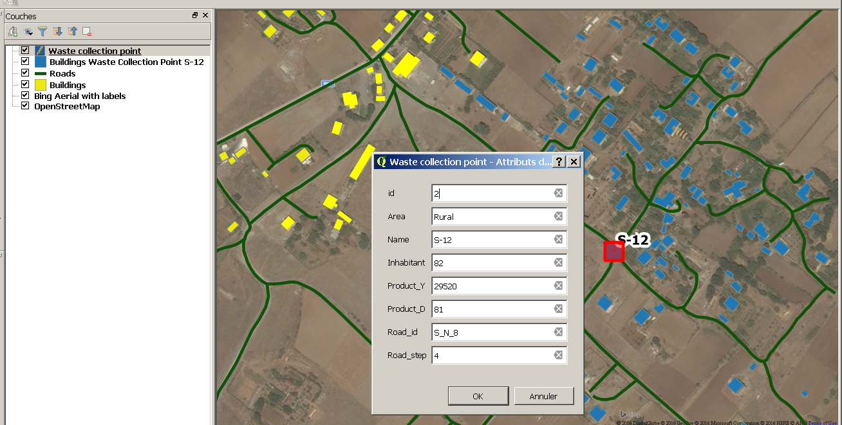
GIS Example
In this example we can see all the houses and roads around a waste collection point (red)
- a program routine can show all the houses which are les than 200 m (as an example, in blue ) by road to the waste coll. point and calculate the number of bins.

Slide 16
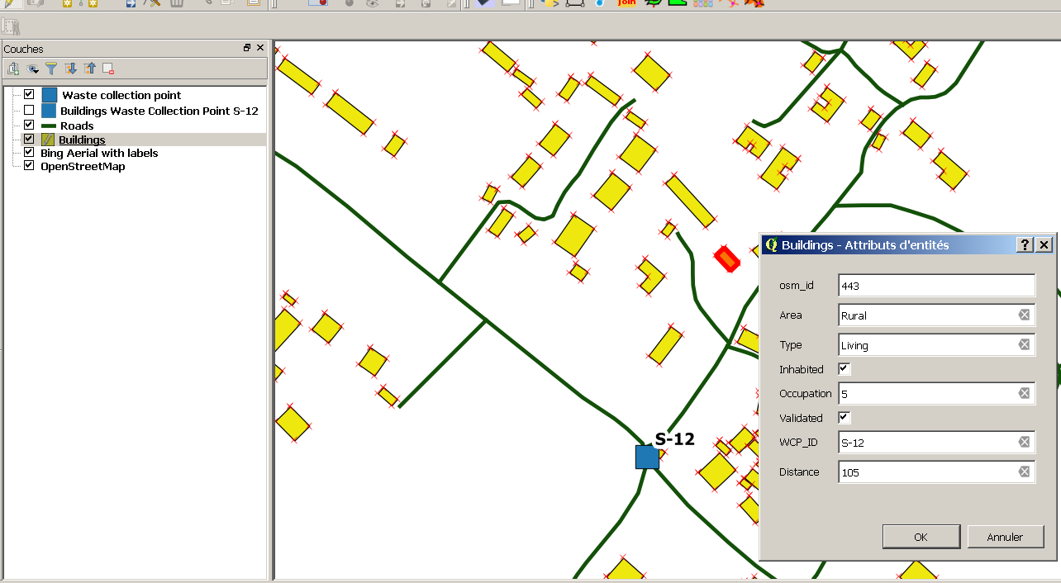
GIS Example
Each houses (in red) can be defined with different attributes (address, occupation, type, number of families/inhabitants, etc) which can be defined step by step or cross-checked with other databases (electricity, water, etc)

Slide 17
Trends : facing the lack of resources
  Waste Management Plans as a response to the lack of resources
    Short term action plans for facing immediate challenges
    Priority to high potential tariff recovery areas
    Introduction of cost and tariff calculation in plan development :
          How much each scenario will cost to the citizen ?
          Which tariff families / business have necessary ?
          What are possible objectives of progressive tariff recovery improvements
      step by step improvement of service provision linked with cost recovery objectives, based on performance indicators and cost calculation
    Training at all levels

Slide 18
Facing the regional treatment need
    Propositions :
    Regional/national approach,
      including transport optimization, transfer station and landfill site definition, in a middle and long term vision : KfW engaged study
    Cost Calculation Model for landfill, for integration in cost model : dldp/CSD proposition

